Slide 1
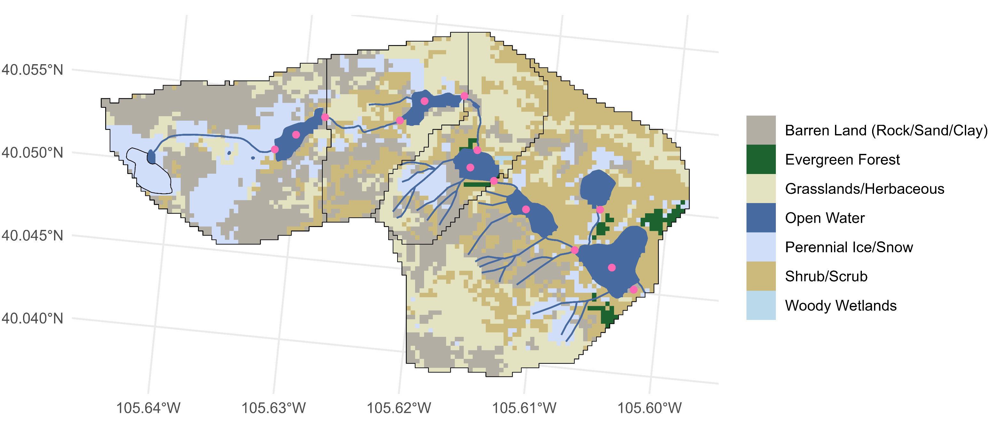
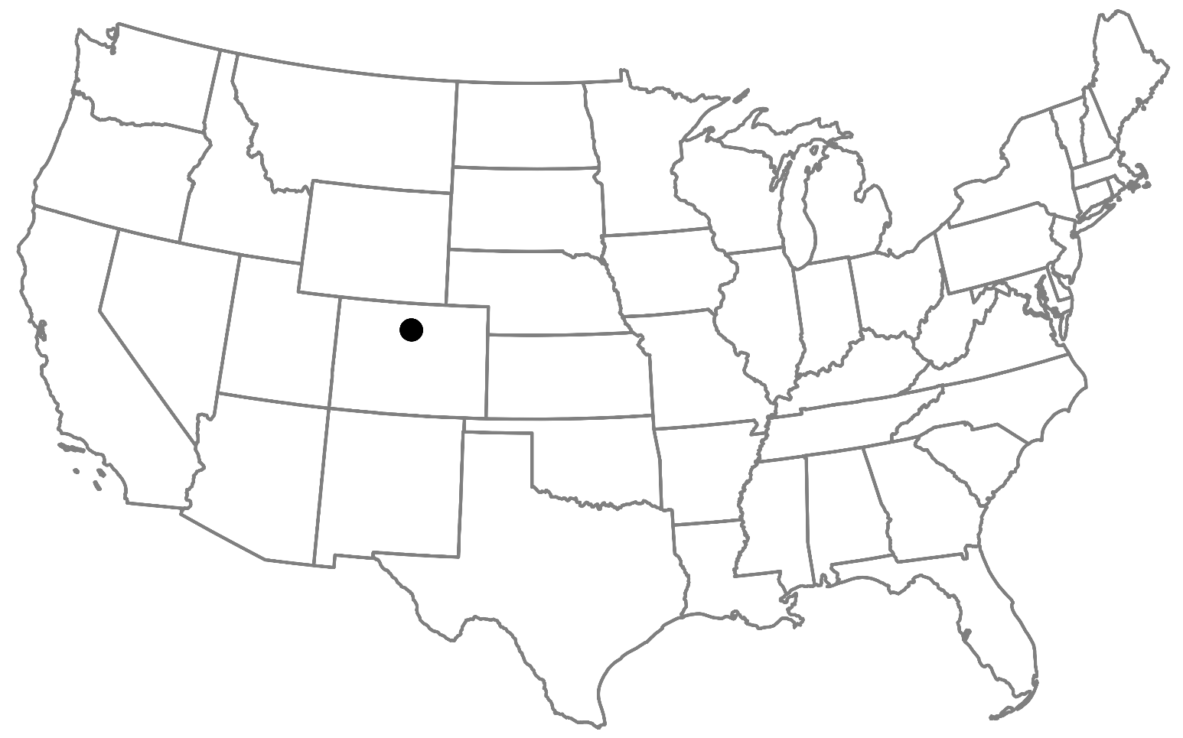
GL4
GL3
Total drainage area: 5.5 km²
Elevation: 3748 m at Arikaree Glacier to 3352 m at Albion outlet
GL5
ALB
27.6%
27.3%
23.8%
Arikaree Glacier
14.8%
5.20%
1.20%
0.07%
Flow direction and network position

